Slide 1
Outline chapter three
Introduction to rendering process with openGL
The role of OpenGL in the reference model Coordinate systems
Output primitives and attributes.

Slide 2
Introduction to rendering process with openGL
OpenGL is a software interface allows programmer to create 2D and 3D graphics images.
It is hardware and OS independent graphics standard.
it is an open source(free) graphics rendering API
It has many rendering commands(primitives) and data types.
OpenGL can render:
  Geometric primitives
    Lines, points, polygons, etc…
  Bitmaps and Images
    Images and geometry linked through
    texture mapping

Slide 3
OpenGL library
GL(OpenGL)
defined 10 geometry primitives and attributes
it supports d/t data types and texture mapping.
OpenGL commands prefix with “gl” substring.
GLU(OpenGL Utility)
Used to design spheres, cones, open cylinders, and tesselated disks for circles and arcs.
viewing(perspective/orthographic)
Commands start with “glu” substring

Slide 4
openGL library
GLUT(openGL Utility Toolkit)
opens windows, develops menus, and manages events(keyboard, mouse).
Prefix with “glut” substring

Slide 5
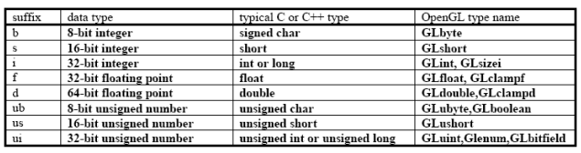
Output primitives and attributes
Primitives: simple geometric objects having a simple relation between a list of vertices.
Data types:- used to declare variables/specify storage size.

Slide 6
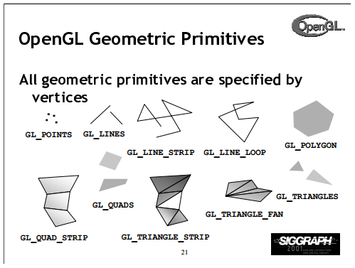
OpenGL primitives

Slide 7
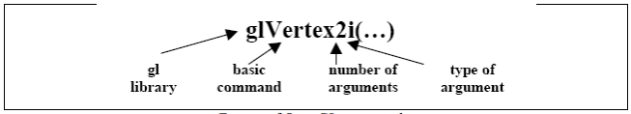
OpenGL drawing primitives
All of these primitives are specified using a sequence of vertices.
A syntax to define a vertex is
OpenGL syntax to draw a primitive
glBegin(primitive);
//vertices;
glEnd( ) ;

Slide 8
Drawing primitives
For example, drawing three point primitives
glBegin(GL_POINTS);
glVertex3f(1.0,2.0,0.0); //point 1
glVertex3f(3.0,5.0,0.0); //point 2
glVertex3f(1.0,2.0,0.0); //point 3
glEnd();
The above code draws three points

Slide 9
Drawing primitives
For example, drawing three point primitives
glBegin(GL_LINES);
glVertex2i(1, 2); line 1
glVertex2i(10,20);
glVertex2i(15,20); line 2
glVertex2i(15,2);
glEnd();
The above code draws two separate lines.

Slide 10
Drawing primitives
glFlush();
Used to write the drawing on the screen.
  Attributes are properties of geometry primitives.
  Common geometrical primitive attributes are:-
  Color, line width, texture, point size etc.

Slide 11
GLUT Basic Functions
glutInit :-allows application to get command line arguments and initializes system.
gluInitDisplayMode:-requests properties for the window
(the rendering context) RGB color, Single buffering, Properties logically ORed together.
glutInitWindowSize in pixels
glutInitWindowPosition:-from top-left corner of display
glutCreateWindow:- create window with title “simple”
glutDisplayFunc:-display callback
glutMainLoop:-enter infinite event loop

Slide 12
OpenGL Program structure
Most OpenGL programs have a similar structure that consists of the following functions
main():
• enters event loop (last executable statement)
init(): sets the state variables
• specifies the callback functions
• opens one or more windows with the required properties
• viewing
• attributes

Slide 13
Program structure cont’d
Callback
• Display function
• Input and window events function

Slide 14

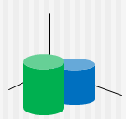
OpenGL Coordinate system
Modeling coordinate system:-putting geometries on a series of coordinate system.
Model transformation
World coordinate system:-composite geometries transformed to proper location in the world coordinate.
View transformation

Slide 15

OpenGL CS cont’d
View coordinate system:-This is equivalent to leaving the camera at the origin and doing inverse transforms on the objects to place them into a viewer coordinate system.
OpenGL uses [ MODELVIEW] command to put objects in VCS.
Projection/Clipping coordinate system:-the system may use transforms to bring the geometry into a normalized coordinate range(0,1)

Slide 16
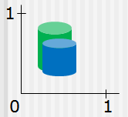
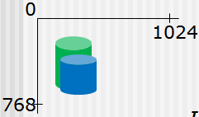
OpenGL CS cont’d
OpenGL uses [PROJECTION] command to place geometries in CCS.
Device Coordinate System:-finally the image is rendered onto a specific device so the geometry is transformed to device coordinates.
Uses [glViewport]
command to place object
in DCS.

